Slide 1

Principles of Macroeconomics 3e
Chapter 3 DEMAND AND SUPPLY
PowerPoint Image Slideshow

Slide 2
Ch.3 OUTLINE
3.1: Demand, Supply, and Equilibrium in Markets for Goods and Services
3.2: Shifts in Demand and Supply for Goods and Services
3.3: Changes in Equilibrium Price and Quantity: The Four-Step Process
3.4: Price Ceilings and Price Floors
3.5: Demand, Supply, and Efficiency

Slide 3
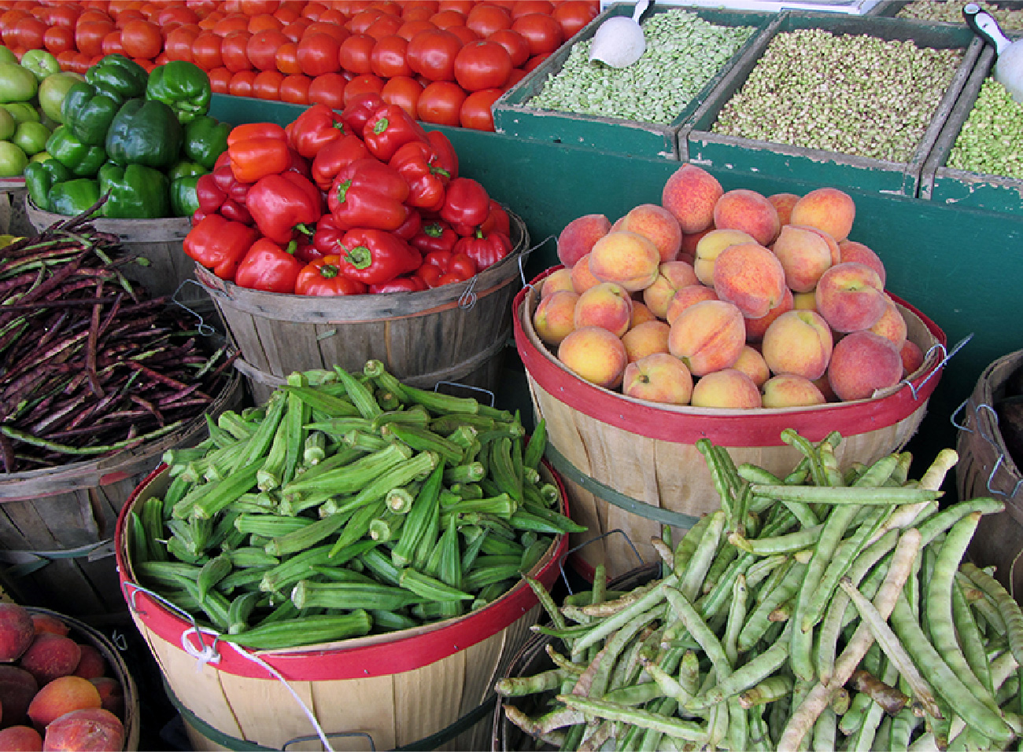
Why Does It Cost More?
Organic vegetables and fruits that are grown and sold within a specific geographical region should, in theory, cost less than conventional produce because the transportation costs are less. That is not, however, usually the case. This is caused by demand and supply.
(Credit: modification of "Old Farmers' Market" by NatalieMaynor/Flickr, CC BY 2.0)

Slide 4
You shouldn’t assume…but, just this once…
Ceteris paribus - Latin phrase meaning “other things being equal”

Slide 5
Fundamental Terminology
TWO TYPES OF SLOPE:
Upward Slope – indicates a positive (direct) relationship
Downward Slope – indicates a negative (indirect) relationship

Slide 6
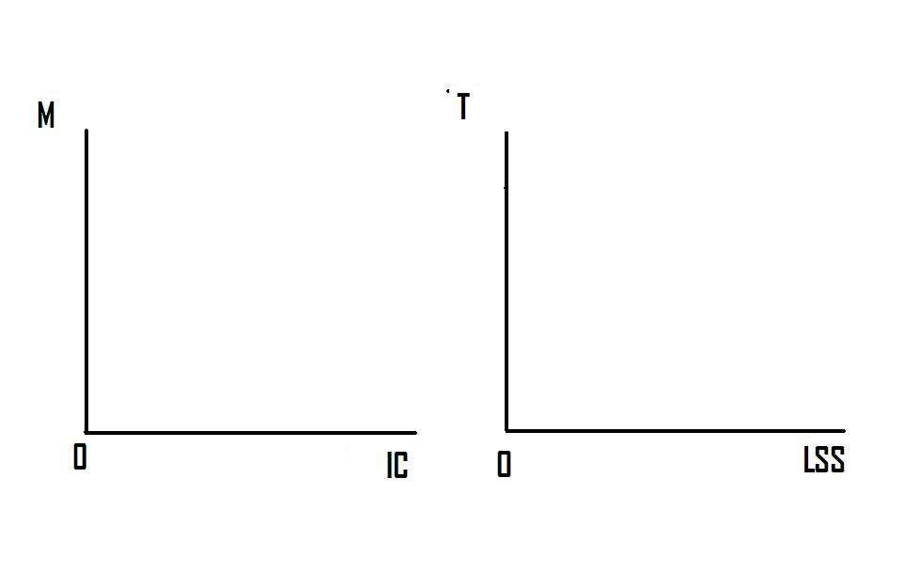
Murder & Ice Cream; Temperature & Long Sleeve Shirts – Any Correlation?

Slide 7
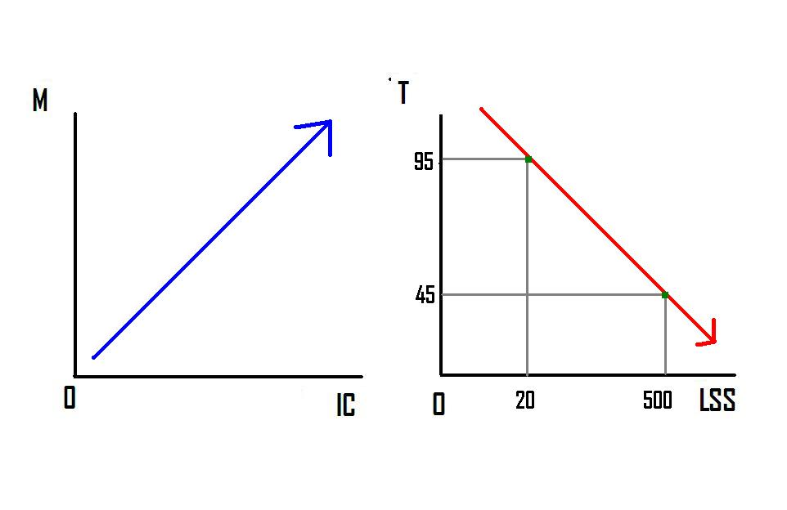
Murder & Ice Cream; Temperature and Long Sleeve Shirts – Positive or Negative?

Slide 8
Fundamental Terminology
TWO WAYS MARKET IMPACTS ARE DISPLAYED GRAPHICALLY:
Shift – the entire curve moves
(increase to the right, decrease to the left)
Movement along the curve – from point to point

Slide 9
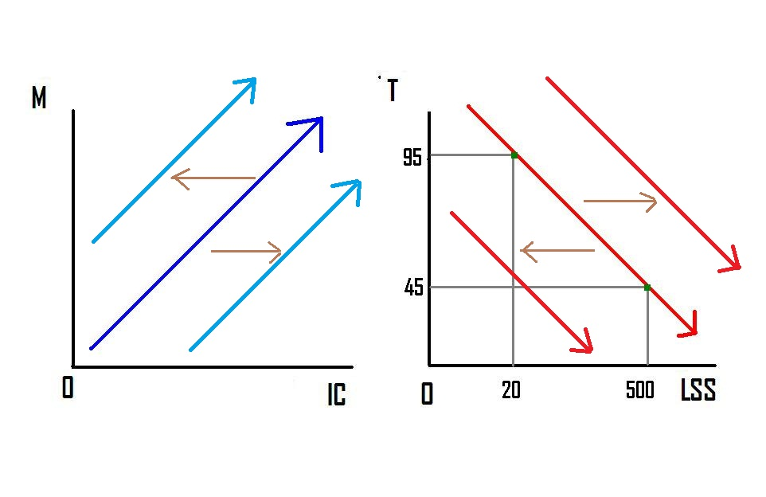
Murder & Ice Cream; Temperature & Long Sleeve Shirts What if something happens???

Slide 10
3.1 Demand, Supply, and Equilibrium in Markets for Goods and Services
Demand - the amount of some good or service consumers are willing and able to purchase at each price. (any price/all prices)
Quantity demanded - the total number of units of a good or service consumers are willing to purchase at a given price. (specific/exact)
Law of demand - keeping all other variables that affect demand constant,
if price goes , then quantity demanded goes
if price goes , then quantity demanded goes

Slide 11
Demand Schedule
 |  |  | Demand Schedule for Coffee
 | Price Per Cup |  |  | Quantity Demanded |  | (Cups/Day
 | $5.00 |  |  |  |  | 100
 | $4.50 |  |  |  |  | 200
 | $4.00 |  |  |  |  | 300
 | $3.50 |  |  |  |  | 400
 | $3.00 |  |  |  |  | 500
 | $2.50 |  |  |  |  | 600
 | $2.00 |  |  |  |  | 700
Demand schedule - a table that shows a range of prices for a certain good or service and the quantity demanded at each price.

Slide 12
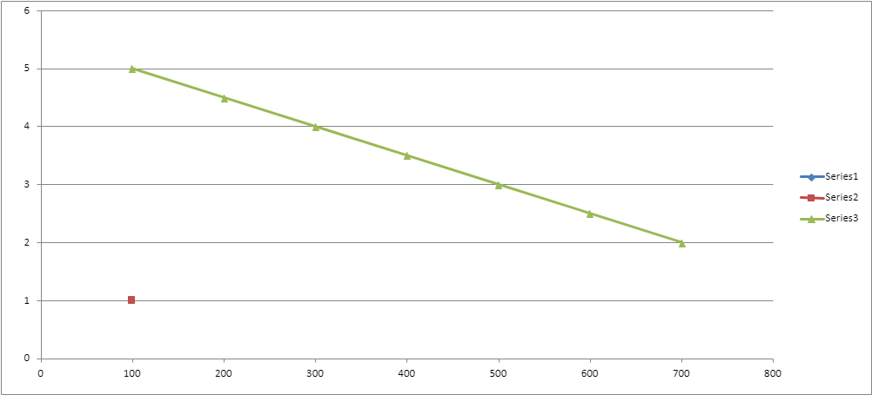
Demand Curve for Coffee

Slide 13
What Factors Affect Demand?
A shift in demand happens when a change in some economic factor (other than price) causes a different quantity to be demanded at every price.
Factors that affect demand:
Income
Normal good - A product whose demand rises when income rises, and vice versa.
Inferior good - A product whose demand falls when income rises, rises, and vice versa.
Changing tastes or preferences
Changes in the composition of the population
Price of substitute or complement changes
Substitute - a good or service that we can use in place of another good or service
Complements - goods or services that are often used together so that consumption of one good tends to enhance consumption of the other.
Changes in expectations about future

Slide 14
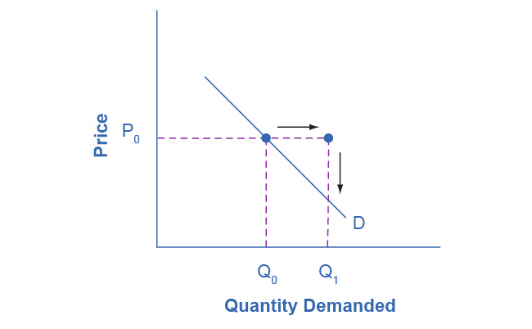
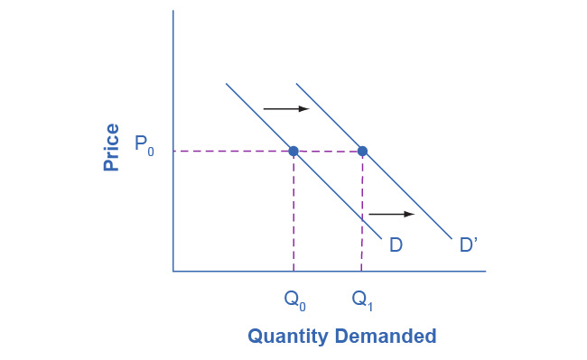
Shifting the Demand Curve
Figure A
Figure B
If income increases:
Consumers will purchase larger quantities, pushing demand to the right (figure A).
Thus, causing the demand curve to shift right (figure B).

Slide 15
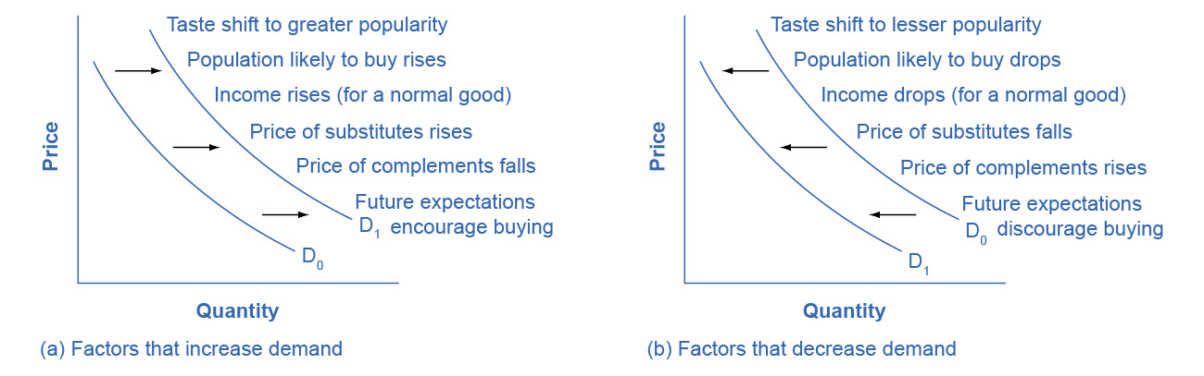
How Factors Affect Demand
(a) A list of factors that can cause an increase in demand from D₀ to D₁.
(b) The same factors, if their direction is reversed, can cause a decrease in demand from D₀ to D₁.

Slide 16
Supply of Goods and Services
Supply - the amount of some good or service a producer is willing to supply at each price.
Quantity supplied - the total number of units of a good or service producers are willing to sell at a given price.
Law of supply - assuming all other variables that affect supply are held constant,
if price goes , then quantity supplied goes
if price goes , then quantity supplied goes

Slide 17
Supply Schedule
 |  |  | Supply Schedule for Coffee
 | Price Per Cup |  |  | Quantity Supplied |  | (Cups/Day
 | $5.00 |  |  |  |  | 900
 | $4.50 |  |  |  |  | 800
 | $4.00 |  |  |  |  | 700
 | $3.50 |  |  |  |  | 600
 | $3.00 |  |  |  |  | 500
 | $2.50 |  |  |  |  | 400
 | $2.00 |  |  |  |  | 300
Supply schedule - a table that shows a range of prices for a certain good or service and the quantity supplied at each price.

Slide 18
Supply Curve for Coffee

Slide 19
What Factors Affect Supply?
Shift in supply - when a change in some economic factor (other than price) causes a different quantity to be supplied at every price.
Factors that affect supply:
Input prices - the costs of labor, materials, and machinery that are used to produce goods and services.
Natural conditions
Technology
Government policies

Slide 20
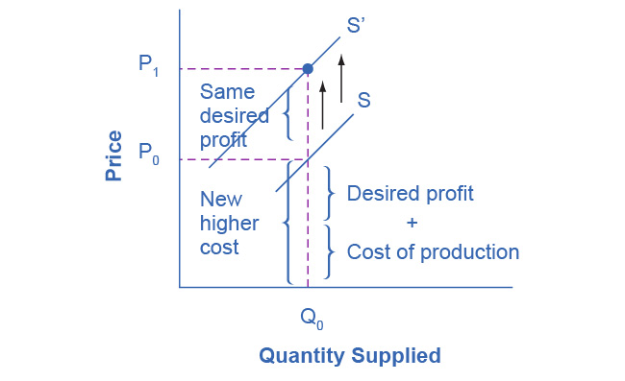
Shifting the Supply Curve
When the cost of production increases, the supply curve shifts LEFT to a new price level.

Slide 21
Equilibrium - Where Demand and Supply Intersect
Equilibrium - the combination of price and quantity where there is no economic pressure from surpluses or shortages that would cause price or quantity to change
quantity demanded = quantity supplied
Equilibrium price - the price where quantity demanded is equal to quantity supplied
Equilibrium quantity - the quantity at which quantity demanded and quantity supplied are equal for a certain price level.

Slide 22
Too much, or too little?
Surplus or excess supply - at the existing price, quantity supplied exceeds the quantity demanded.
Shortage or excess demand - at the existing price, the quantity demanded exceeds the quantity supplied.

Slide 23
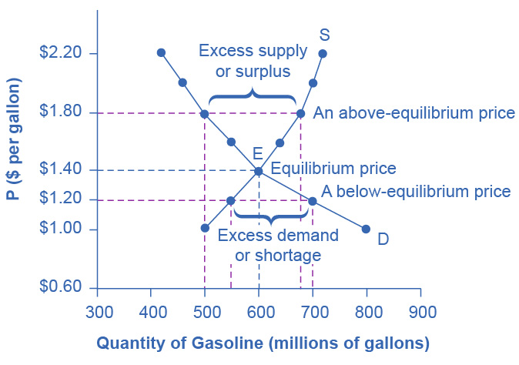
Equilibrium - Where Demand and Supply Intersect
The demand curve (D) and the supply curve (S) intersect at the equilibrium point E.
The equilibrium price is the only price where,
quantity demanded = quantity supplied
At a price above equilibrium, quantity supplied > quantity demanded, so there is excess supply.
At a price below equilibrium, quantity demanded > quantity supplied, so there is excess demand.

Slide 24
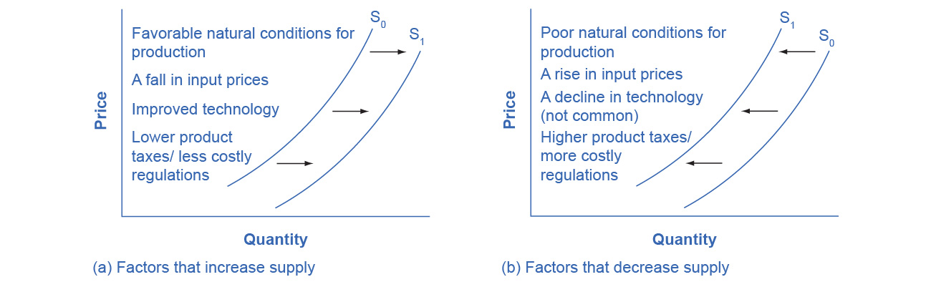
How Factors Affect Supply
(a) A list of factors that can cause an increase in supply from S₀ to S₁.
(b) The same factors, if their direction is reversed, can cause a decrease in supply from S₀ to S₁.

Slide 25
3.3 Changes in Equilibrium Price and Quantity: The Four-Step Process
Four-step process to determining how an economic event affects equilibrium price and quantity:
Step 1. Draw a demand and supply model before the economic change took place.
Step 2. Decide whether the economic change affects demand or supply.
Step 3. Decide whether the effect causes a curve shift to the right or to the left, and sketch the new curve on the diagram.
Step 4. Identify the new equilibrium and then compare to the original.

Slide 26
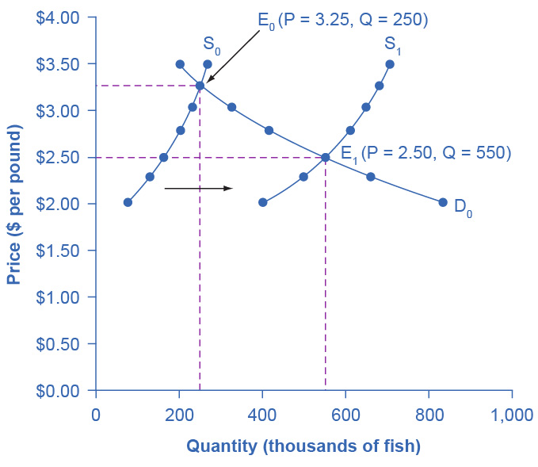
Example: Shift in Supply
Discussion Question: Using the 4-step approach, how did excellent weather conditions during the summer affect the quantity and price of salmon?

Slide 27
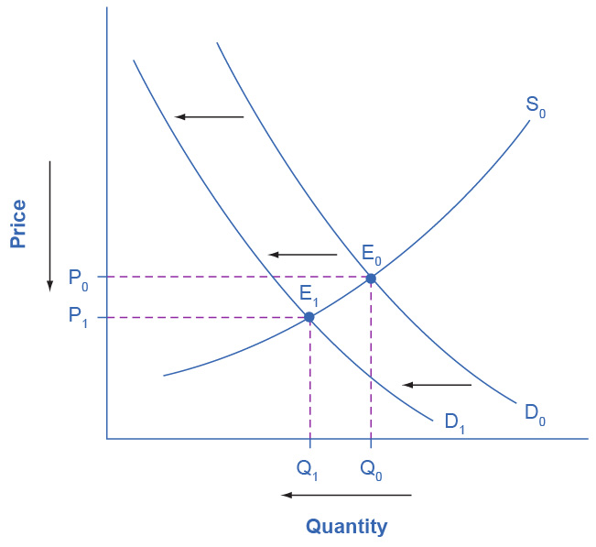
Example: Shift in Demand
Discussion Question: From 2004 to 2012, the share of Americans who reported obtaining their news from digital sources increased from 24% to 39%. Using the 4-step approach, how has this affected the consumption of traditional sources, such as print news media, and radio and television news?

